Slide 1
DISCLAIMER
Investing in cryptocurrency is subject to market risk. Cryptocher does not give any investment advice. It is just a Crypto educational platform, where the information provided is the expert’s opinion about the market and best investment efforts. Invest based on your research and analysis. Cryptocher is not responsible for any financial loss; you can invest anywhere as per your analysis with caution. Anybody over 18 years old is eligible to invest and make their own investment decisions as per their understanding and responsibility.

Slide 16
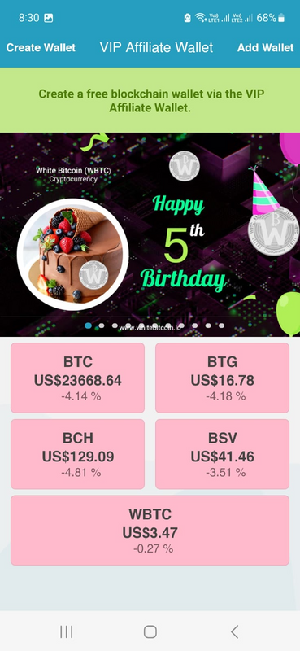
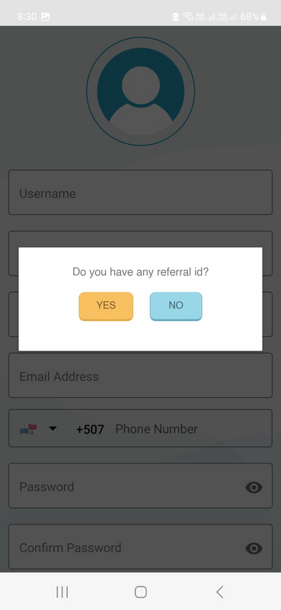
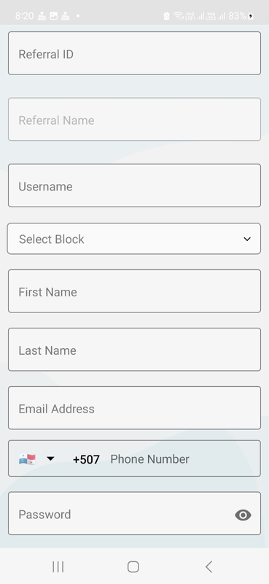
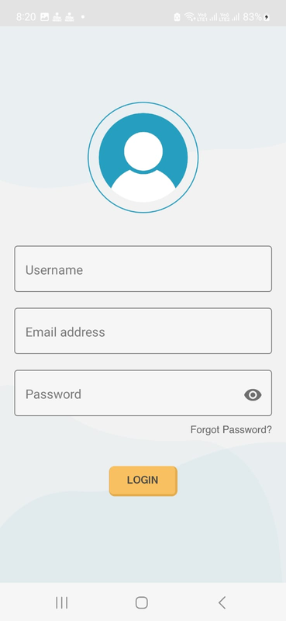
HOW TO SIGN UP
When you create your wallet, you have to generate your private key immediately and save it. Whether on email or on WhatsApp, wherever you can save it.

Slide 18
CRYPTOCHER
WE CAN GENERATE INCOME IN SIX DIFFERENT WAYS.
1
For Example, Let us consider a block of 2000$
If we keep our investment hold for at least 4 years, we Increase our fund value.
Feb, 2018 1 WBTC = 0.14 $
2000$ means = 14285 WBTC
Today Feb, 2023, 1 WBTC= 3.5$
Then, our fund value is 14285 X3.5 $ = 49997.5 $
[ 25x Growth in 5 year from just invest & hold]
0.14 $
3.5 $
25x
Feb 2018
Feb 2023
in 5 years

Slide 19
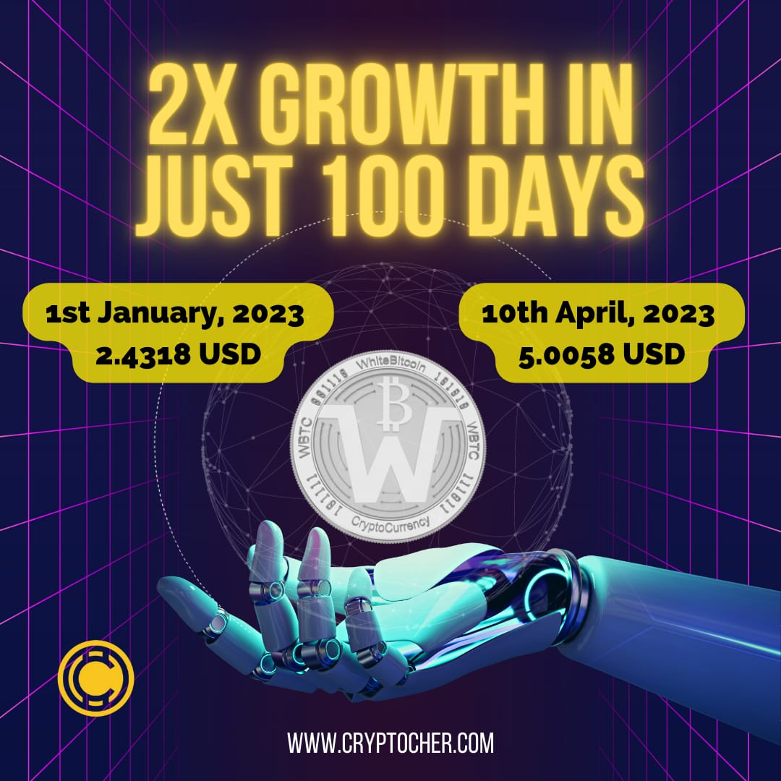

Slide 20
CRYPTOCHER
2
You can refer anyone and get direct dividend of 10% from mining server immediately (5% Admin Charge deducted)
200$ FROM A
You
200$ FROM B
Refer A
Refer B
2000$
2000$
Your Total Reward Income is 400$ instant.

Slide 21
CRYPTOCHER
3
You Can earn 10% block matching dividend per day depending on your block size from mining server in ratio of 1:1
SIDE A
You
SIDE
B
15000$
12000$
Block Matching income is 1200$. Extra business of any side will carry forward for next time.

Slide 22
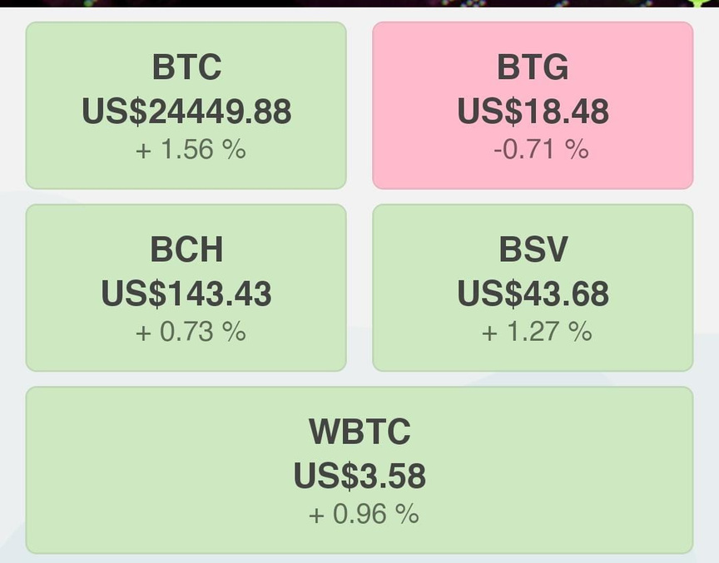
CRYPTOCHER
4
Earn more wbtc guaranteed from Staking
distribution of rewarded wbtc will be monthly basis
(rewarded wbtc divided in total month)

Slide 23
CRYPTOCHER
5
Staking referal income (for you)
Distribution of earned wbtc will be monthly basis ( staking reward divided in total month)

Slide 24
CRYPTOCHER
6
Even after completion of the refer and earn program of VIP affiliate, if you start holding continue in the wallet and if you have 2% holding then you will get the extra monthly reward from mining hase power.

Slide 25
GET IN TOUCH
WITH US
Register with us and become a Crypto Wizard !
Phone Number
visiting our website in team support
Email Address
cryptoocher@gmail.com
Instagram
@cryptocher
Website
www.cryptocher.com

